Slide 1

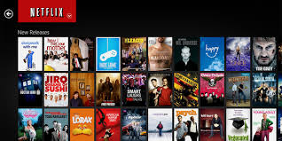


Urvi Pasad
Netflix Movie Recommendations
Term 5: Netflix Movie Recommendations
Batch : October 19 Cohort

Slide 2
Problem Statement
Netflix is all about connecting people to the movies they love. To help customers find those movies, they developed world-class movie recommendation system: CinematchSM. Its job is to predict whether someone will enjoy a movie based on how much they liked or disliked other movies. Netflix use those predictions to make personal movie recommendations based on each customer’s unique tastes.
This project aims to build a movie recommendation mechanism within Netflix. The dataset I used here come directly from Netflix. It consists of 4 text data files, each file contains over 20M rows, i.e. over 4K movies and 400K customers.

Slide 3
GOAL
Our goal of this Case study is to Predict the rating that a user would give to a movie that he has not yet rated and Minimize the difference between predicted and actual rating (RMSE and MAPE)

Slide 4

Data Description
Data is collected from below site. https://www.kaggle.com/netflix-inc/netflix-prize-data
There are 24M rows and 3 columns
4499 movies in the dataset, 24058263 ratings from the 475257 users

Slide 5
Data Preprocessing
1
Restructured the data file to extract the movie ids and re-arranged the rows
3
Reduce the size of the data by selecting only year 2005 movies
4
Data visualization using User/Rating parameter to understand the data distribution
2
Check for Sparsity of the Data and filter the sparse data

Slide 6
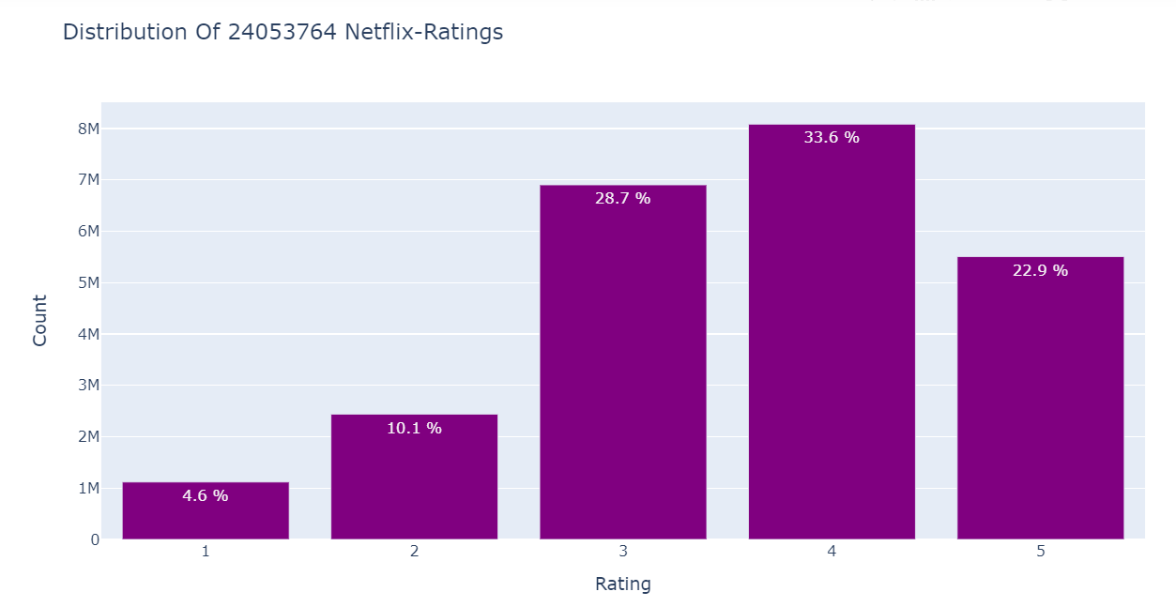
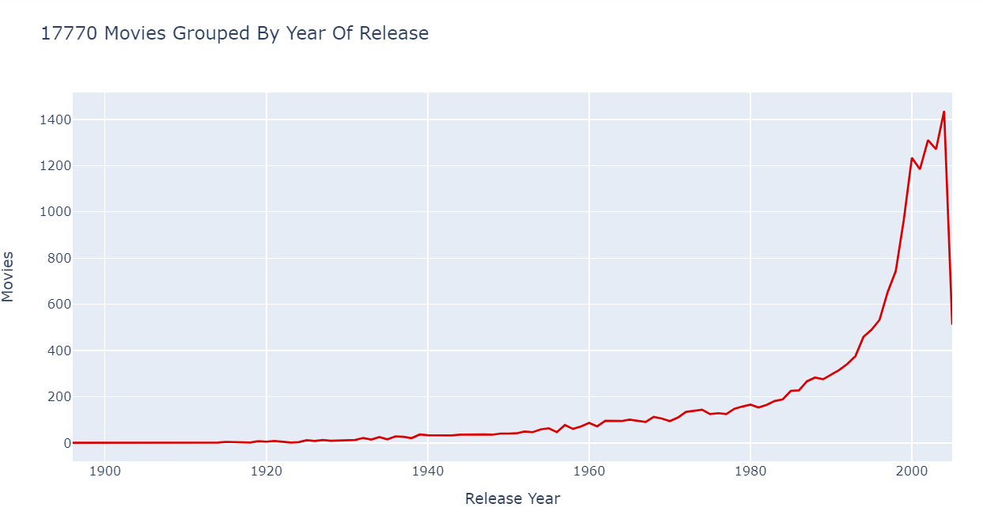
Data Visualization
Rating distribution
MOVies by year of release

Slide 7
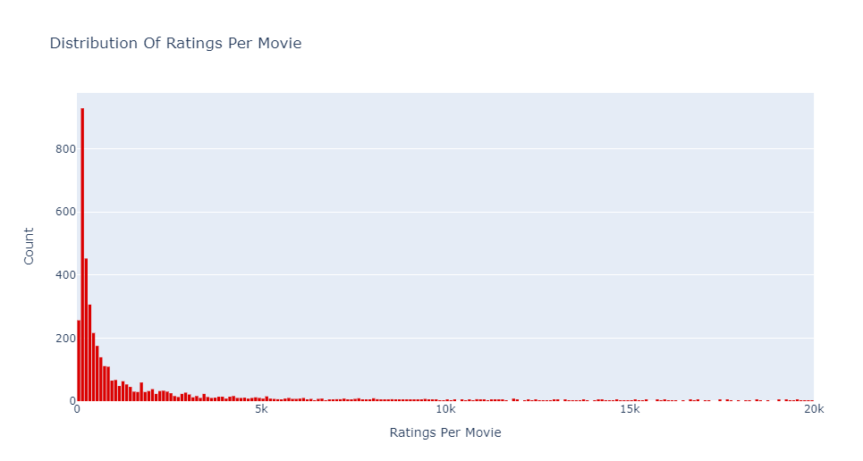
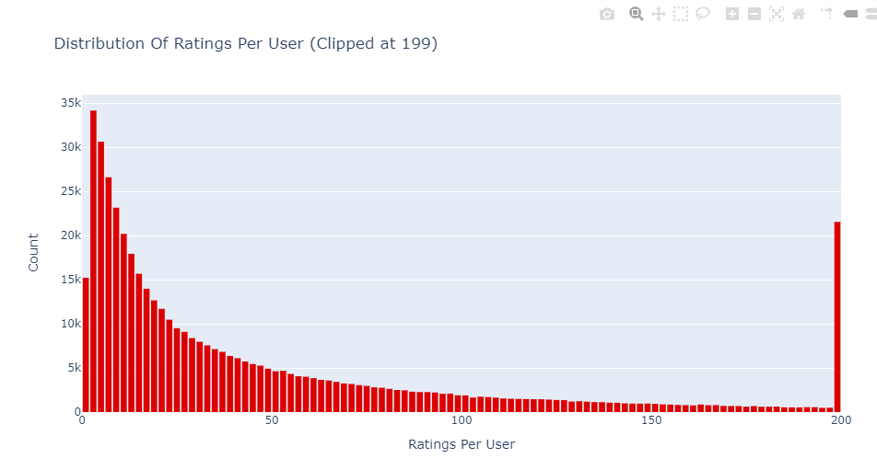
Data Visualization
Ratings Per movie
Rating Per User

Slide 8
Recommendation Approach
User User Similarity
Item Item Similarity
Model Based Approach – KNN
Singular Vector Decomposition( SVD)

Slide 9
Model Evaluation
Model | RMSE
User-based CF RMSE | 507262.174265
Item-based CF RMSE | 614872.65082
SVD | 0.9639
BEST MODEL : SVD with Minimum RMSE .9639

Slide 10
Conclusion
Built a movie recommendation system using User User similarity and Item Item Similarity and due to the 87.5% of sparsity of the Data this approach is not viable.
Second approach is use Model based Collaborative filtering using KNN model to predict the movie recommendations for a user.
KNN works better than User User and Item Item similarity.
Use SVD to predict the movie recommendations for a user as well predict the rating for a movie from the User. We achieved a very good results using this approach.

Slide 11
Thank You

